Slide 1
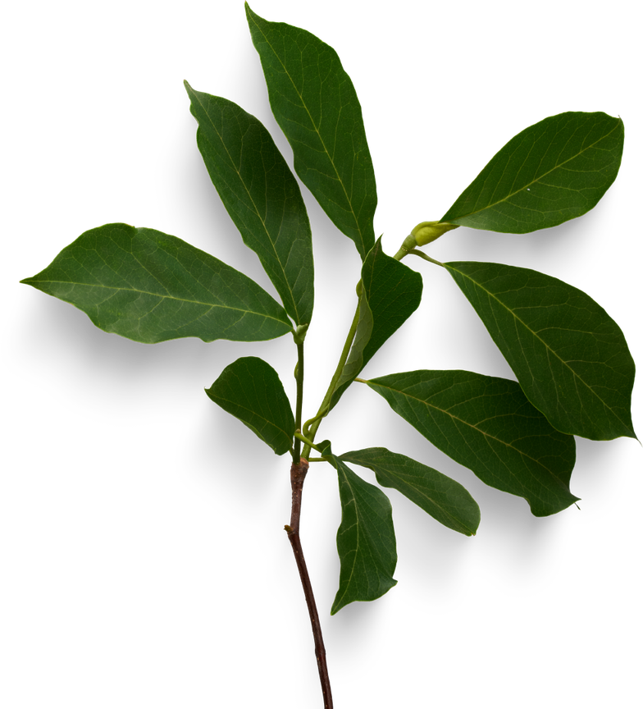
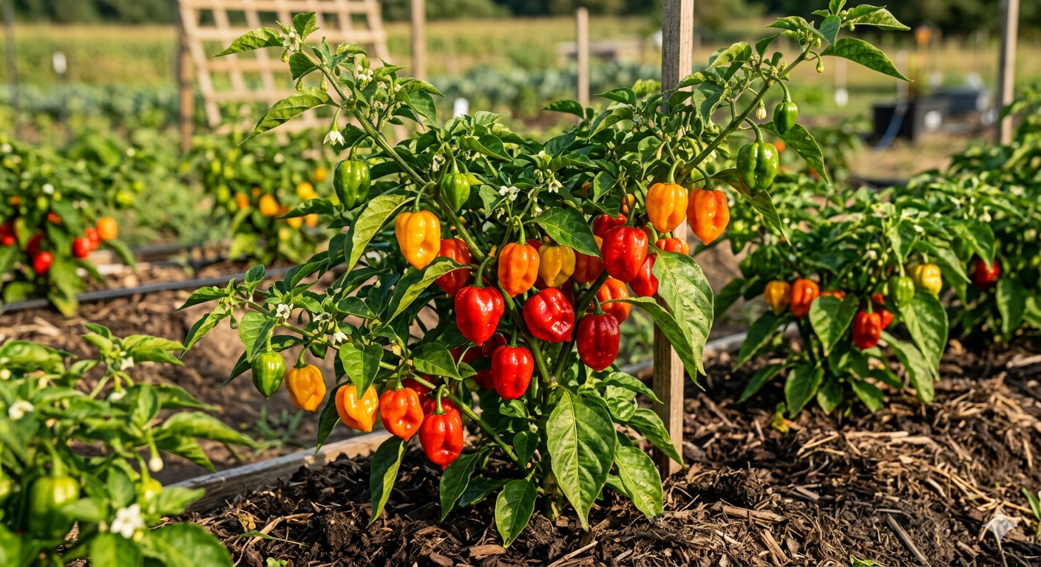

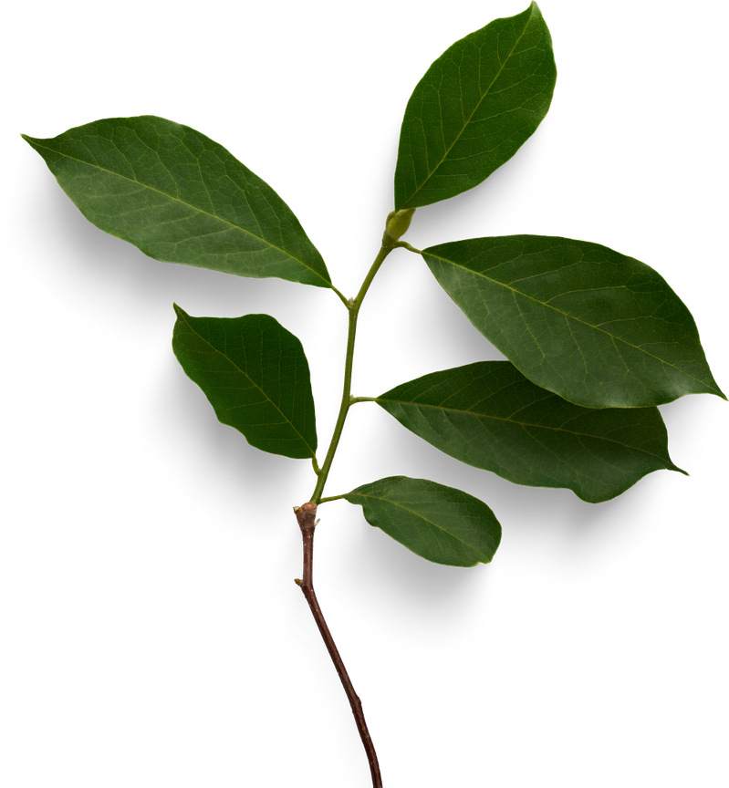
R26-IT-103
NAIMIRIS
A PROFIT-DRIVEN SMART FARMING APP FOR SCOTCH BONNET PEPPERS
PROGRESS PRESENTATION 1

Slide 2

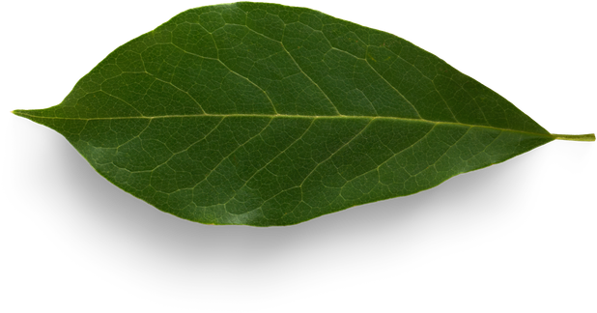
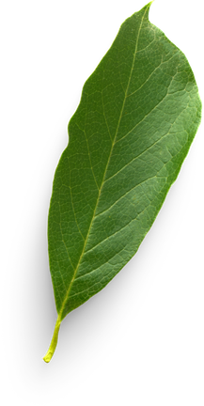
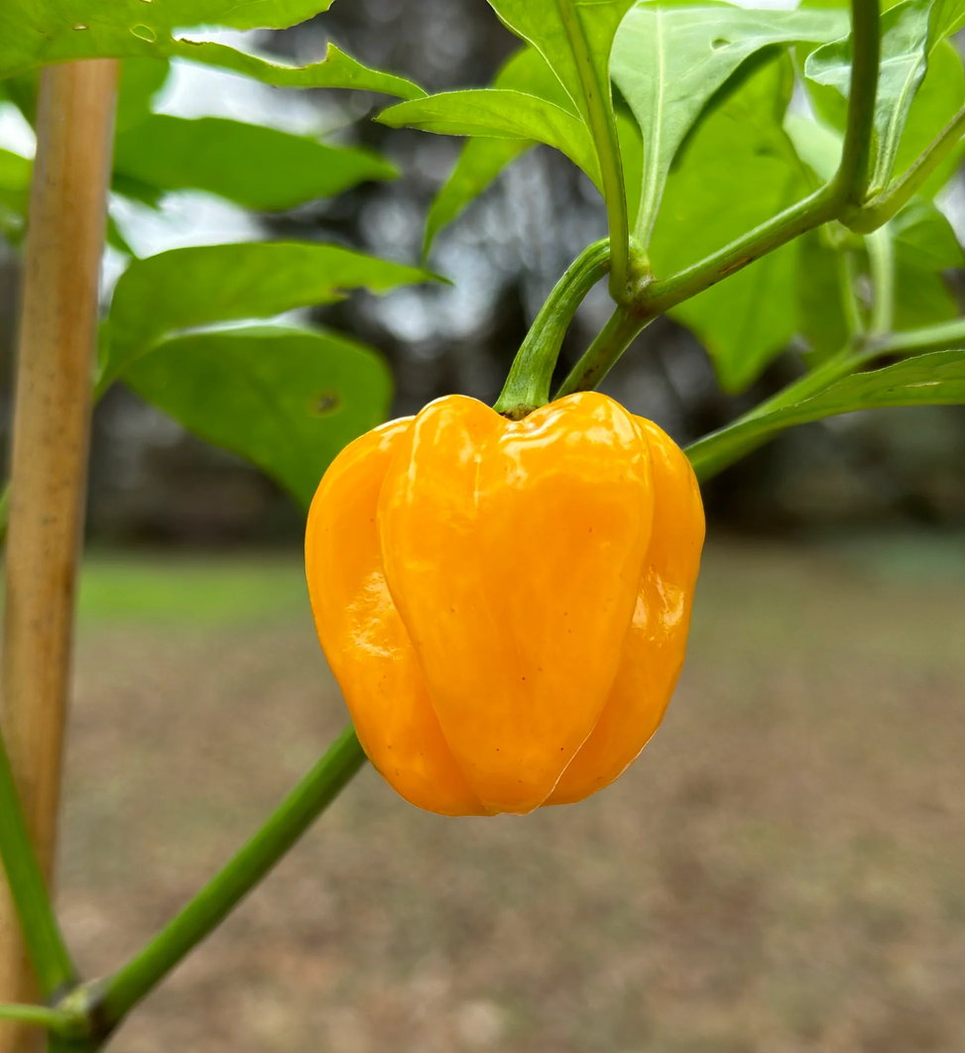

NAIMIRIS
Project Title - Naimiris: A Profit-Driven Smart Farming Model for Scotch Bonnet Peppers
Project ID - R26-IT-103
Supervisor - Ms Sadeepa Dushanthi Kuruppu
Core Supervisor - Ms Chathurangika Kahandawaarachchi
R26-IT-103
2

Slide 3
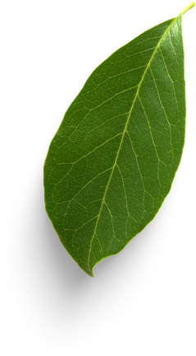
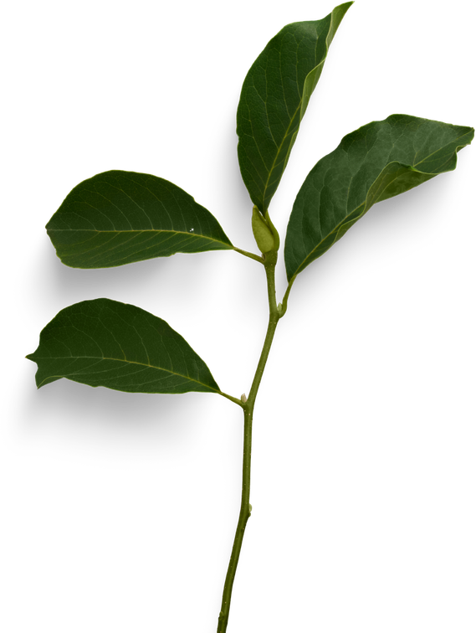
NAIMIRIS
INTRODUCTION
Agriculture is a key sector in Sri Lanka, but many small-scale farmers still use traditional methods which lead to low profit and high risk. NAIMIRIS is a smart farming app designed for wet zone farmers with less than 1 acre of land who want to earn better income from farming. The system provides highly accurate, crop-focused guidance for Scotch Bonnet pepper farming, delivering insights and strategies that are more precise and practical than common farming advice. NAIMIRIS helps farmers reduce risk, increase yield, and turn farming into a profitable business.
R26-IT-103
3

Slide 4

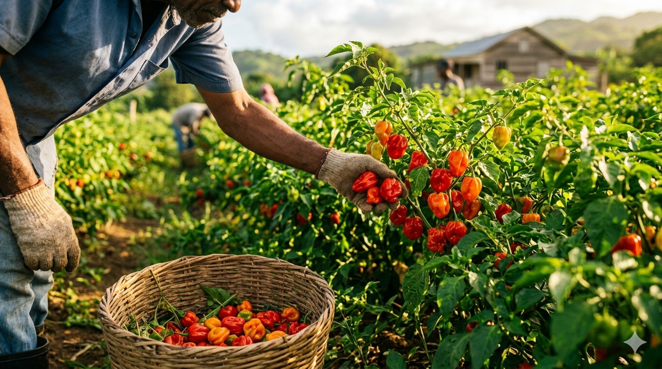
NAIMIRIS
THE PROBLEM
Existing Problems
• Traditional farming focuses on production, not profit
• Low income for small-scale farmers
• Lack of accurate farming guidance
• Dependence on middlemen and poor market access
• Small land sizes limit profitability
Why This is Important
• Farmers work hard but earn low profit
• Farming becomes high risk and unstable
•Farmers cannot treat farming as a profitable business
• Young people avoid agriculture
• Need for a smart, profit-focused farming system
R26-IT-103
5

Slide 5
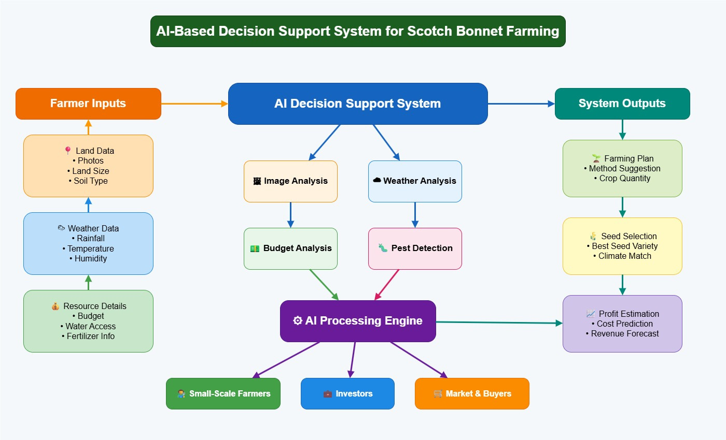
NAIMIRIS
SOLUTION OVERVIEW

Slide 6

NAIMIRIS
PRE-ANALYSIS & SMART
DECISION SUPPORT STAGE
IT22271464 - KUMARAGE K J B H
IT2271464 KUMARAGE K J B HR26-IT-103
7

Slide 7
NAIMIRIS
INTRODUCTION
  Farmers cultivating Nai Miris in Sri Lanka often make farming decisions based on experience rather than data analysis.
  This can lead to financial risk, resource wastage, and unstable profits.
  Existing farming systems do not properly combine land condition, budget, and environmental factors together.
  This research introduces an AI-based smart decision support system to help farmers generate better cultivation plans and profit predictions.
Objective
• To help farmers make data-driven, low-risk, and profit-oriented decisions for Nai Miris cultivation.
IT2271464 KUMARAGE K J B HR26-IT-103
9

Slide 8
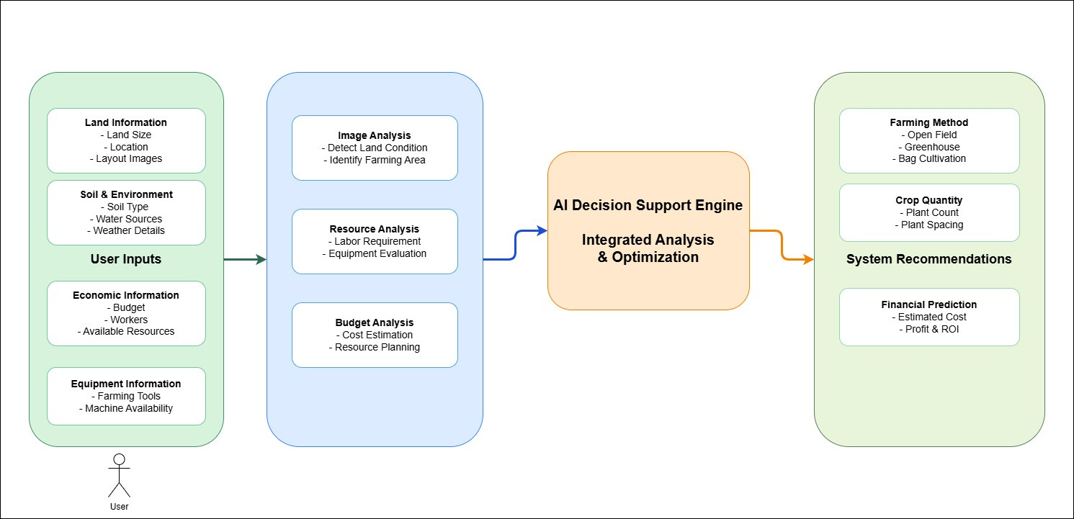
NAIMIRIS
SYSTEM DIAGRAM
IT2271464 KUMARAGE K J B HR26-IT-103
8

Slide 9
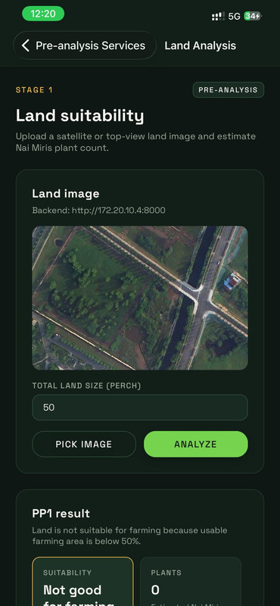
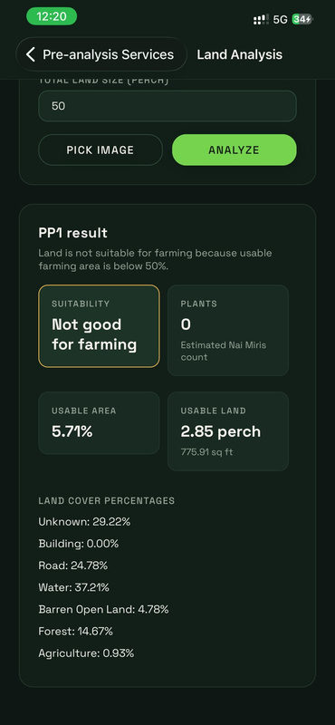
NAIMIRIS
CURRENT PROGRESS
LAND ANALYZER
1. AI Model (Land Analyzer)
  Developed land analysis model using TensorFlow
  Detects land types: Agriculture, Barren, Buildings, Roads, Water, Forest
  Outputs land-cover percentage
2. Backend Development
  Implemented backend logic for land suitability analysis
  Calculates usable farming area from model output
  Decision: Land is suitable or not for farming
  Estimates Nai Miris plant count based on land size
3. Frontend Development
  Developed user interface for farmers
  Image upload + land size input
  Displays results: Land suitability , Estimated plant count
IT2271464 KUMARAGE K J B HR26-IT-103
10

Slide 10
NAIMIRIS
FUTURE WORK
NEXT STEPS
  Improve AI model accuracy
  Reduce unknown area detection
  Implement ROI calculation
  Add cost & profit prediction
  Integrate weather and soil data
  Develop full smart farming recommendation system
IT2271464 KUMARAGE K J B HR26-IT-103
11

Slide 11

NAIMIRIS
TECHNOLOGY-ASSISTED
A-TO-Z FARMING GUIDANCE STAGE
IT22124630 - SAVINDA R.MD
IT22124630 SAVINDA R M D R26-IT-103
12

Slide 12
NAIMIRIS
INTRODUCTION
  Agriculture still relies on manual crop monitoring, making it difficult for farmers to detect growth and environmental problems early.
  Modern technologies such as the Internet of Things (IoT) and Artificial Intelligence (AI) provide new opportunities for smart farming.
  This research develops a technology-assisted farming guidance system for Scotch Bonnet pepper (Nai Miris) cultivation by integrating IoT environmental sensors with AI-based image analysis.
  By analyzing weekly crop images and real-time sensor data, the system identifies growth conditions and provides recommendations such as irrigation or fertilizer adjustments to improve crop productivity.
Objective
• To develop an AI- and IoT-based smart farming system that monitors crop growth stages and environmental conditions to provide technology-assisted cultivation guidance for Nai Miris farming.

Slide 13
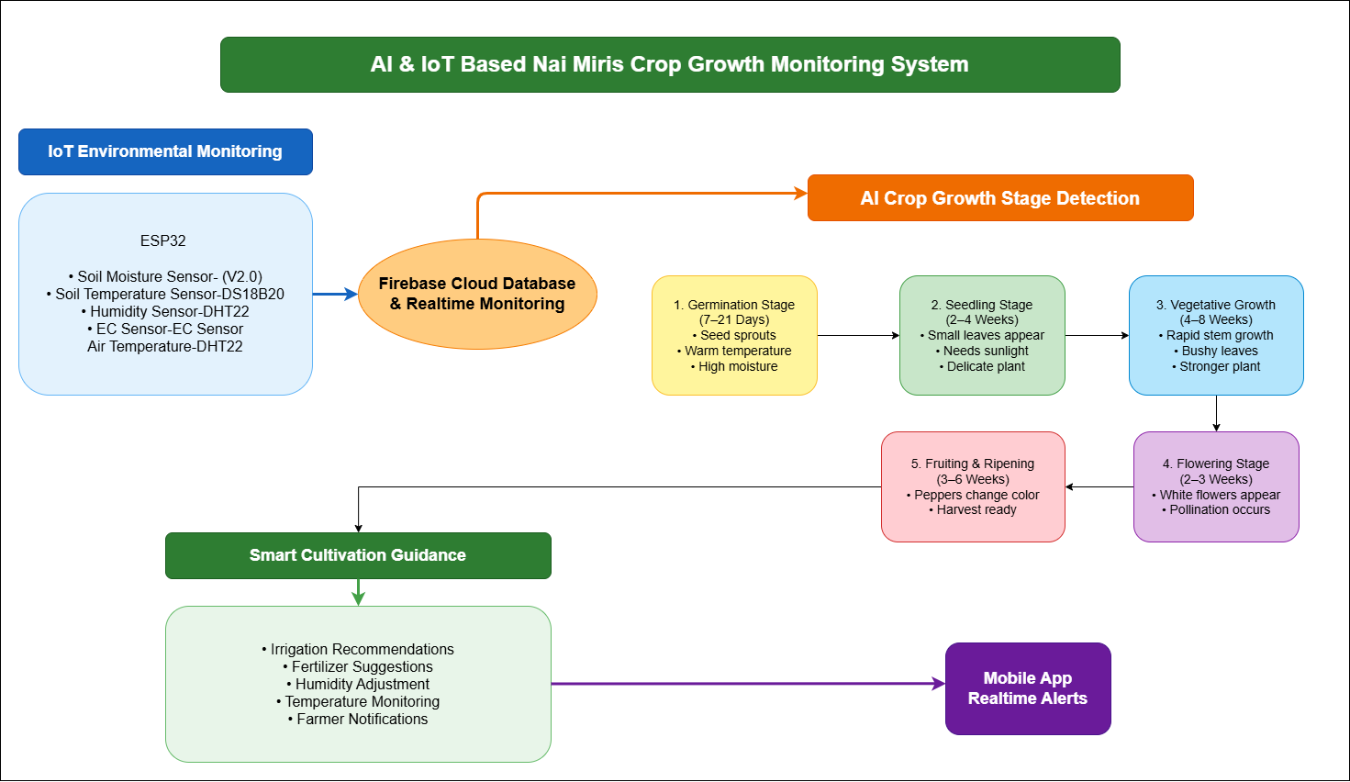
NAIMIRIS
SYSTEM DIAGRAM
IT22124630 SAVINDA R M D R26-IT-103
13

Slide 14
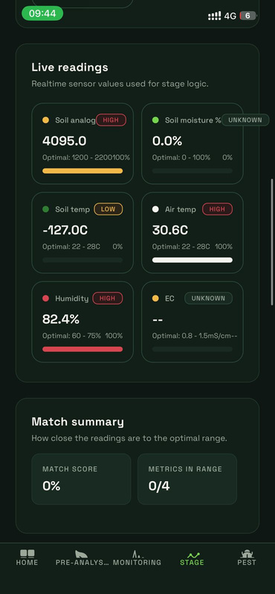
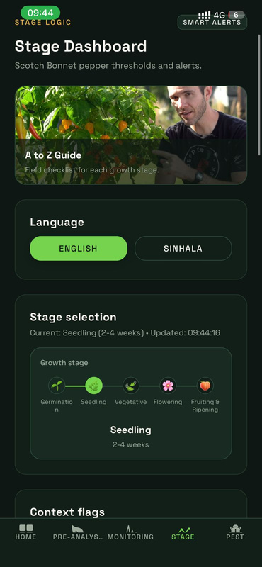
NAIMIRIS
CURRENT PROGRESS
IOT & IMAGE PROCESSING
IoT Development
  Connected environmental sensors with ESP32 / NodeMCU
  Collected realtime temperature, humidity, soil moisture, and EC data
  Sent sensor data to Firebase Realtime Database
  Enabled realtime monitoring and cloud data storage
Backend Development
  Developed backend logic for 5 Nai Miris growth stages
  Processed realtime sensor values and analyzed crop conditions
  Generated growth status, environmental alerts, and recommendations
  Implemented stage-based monitoring system
AI Model Development
  Trained AI model for Germination Stage detection
  Integrated AI prediction with backend processing
  Used growth data for stage identification
Frontend Development
  Developed dashboard for farmers
  Displayed realtime sensor readings and crop growth stages
  Visualized alerts, notifications, and crop condition updates
  Improved user understanding using graphical data representation
IT2271464 KUMARAGE K J B HR26-IT-103
15

Slide 15
NAIMIRIS
FUTURE WORK
NEXT STEPS
Improve Crop Growth Stage Classification Accuracy
  Increase Nai Miris growth-stage image dataset
  Train AI model using different plant growth conditions
  Improve weekly stage prediction accuracy
  Optimize CNN / YOLO model performance
. Integrate Growth Analysis with Sensor Data
  Combine crop image analysis with environmental data
  Validate whether crop growth matches environmental conditions
  Improve growth-stage prediction reliability
Improve Mobile Dashboard Features
  Real-time sensor monitoring dashboard
  Weekly crop growth tracking
  AI analysis results visualization
  Alert and notification system
IT2271464 KUMARAGE K J B HR26-IT-103
16

Slide 16
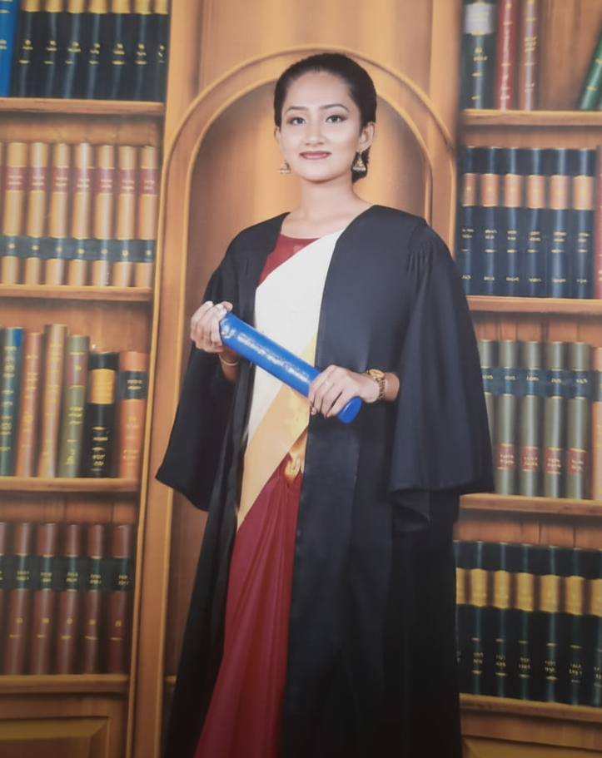
NAIMIRIS
AI-DRIVEN PEST MONITORING AND CONTROL SYSTEM
IT22212740 - GUNAWARDANA T.D.A
IT22212740 GUNAWARDANA T D A R26-IT-103
17

Slide 17
NAIMIRIS
INTRODUCTION
  Pest attacks are a major challenge in Scotch Bonnet pepper (Nai Miris) cultivation in the Sri Lankan wet zone.
  Traditional monitoring is manual and often delayed, causing crop loss.
  This research proposes an AI-based pest monitoring system that detects pests from leaf images, assesses severity, provides accurate pesticide recommendations, and reduces chemical overuse.
  It helps farmers make timely, data-driven decisions and improve yield.
Objective
• Develop an AI-based pest monitoring system for Scotch Bonnet pepper (Nai Miris) that detects pests, evaluates infestation severity, and provides precise treatment recommendations.
IT22212740 GUNAWARDANA T D A R26-IT-103
18

Slide 18
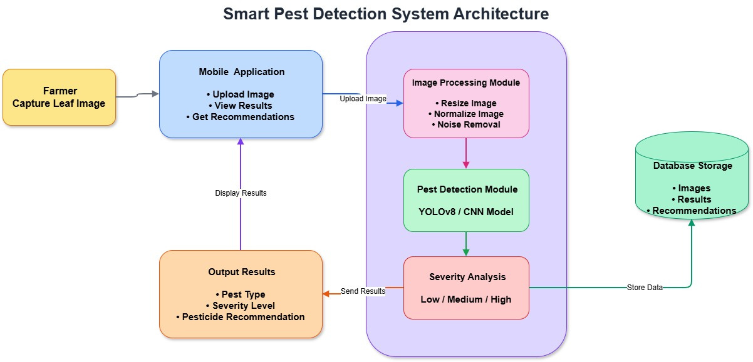
NAIMIRIS
SYSTEM DIAGRAM
IT22212740 GUNAWARDANA T D A R26-IT-103
19

Slide 19
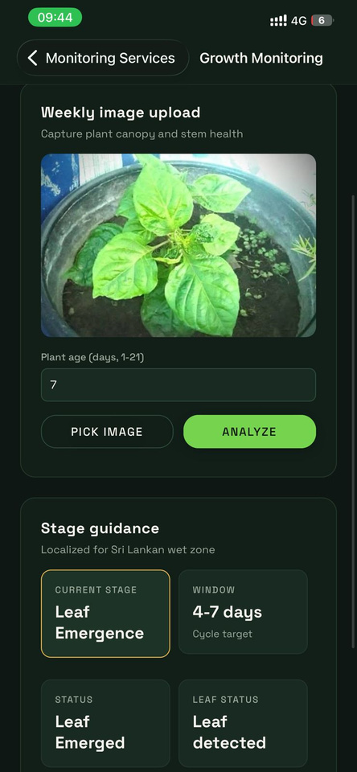
NAIMIRIS
CURRENT PROGRESS
1. AI Model Development (Pest Detection)
  Developed pest and disease detection model using YOLOv8
  Model currently detects:
    Healthy Leaf
    Thrips Damage
    Leaf Spot Disease
    Yellow Virus Disease
  Generates disease prediction with confidence score and detection area
2. Backend Development
  Implemented backend logic for AI prediction system
  Processes uploaded leaf images and returns disease detection results
  Integrated trained YOLOv8 model with prediction workflow
3. Frontend Development
  Developed user-friendly interface for image upload and prediction display
  Displays: Original image , Disease name , Confidence percentage
IT2271464 KUMARAGE K J B HR26-IT-103
20

Slide 20
NAIMIRIS
FUTURE WORK
NEXT STEPS
  Improve AI model accuracy
  Add more pest and disease classes
  Add disease recovery and treatment suggestions
  Improve real-time detection performance
  Develop mobile-friendly application
  Build complete smart pest monitoring system
IT2271464 KUMARAGE K J B HR26-IT-103
21

Slide 21
NAIMIRIS
COMMERCIALIZATION PLAN
The Smart Farming Decision Support System will be offered as a subscription-based platform for farmers and agricultural businesses. Users can access AI-powered farming recommendations, monitoring, and analysis through monthly or yearly plans. The system can also integrate with IoT sensors to collect real-time farming data and improve decision-making. Revenue will be generated through subscriptions, premium services, and agricultural partnerships.

Slide 22
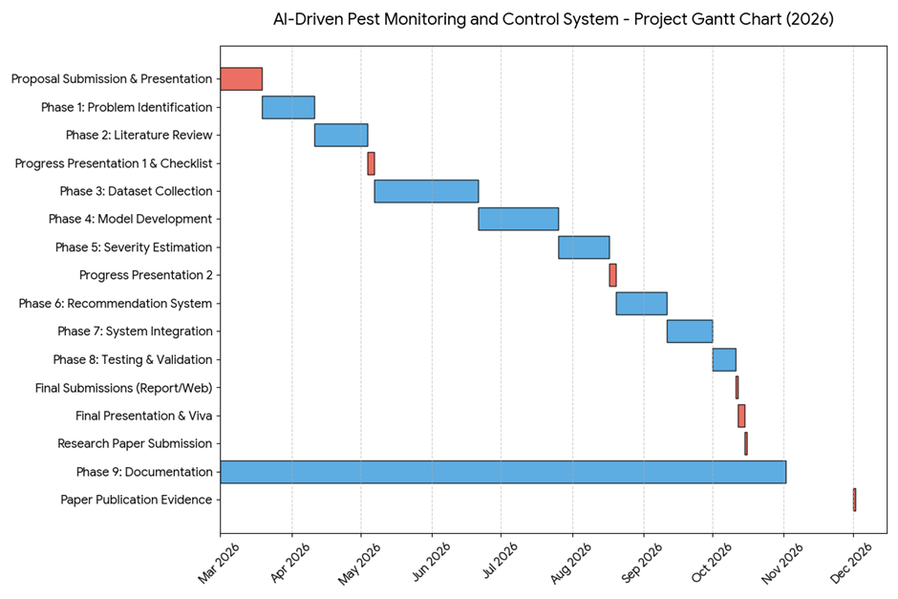
NAIMRIS
WORK BREAKDOWN STRUCTURE
R26-IT-103
23

Slide 23
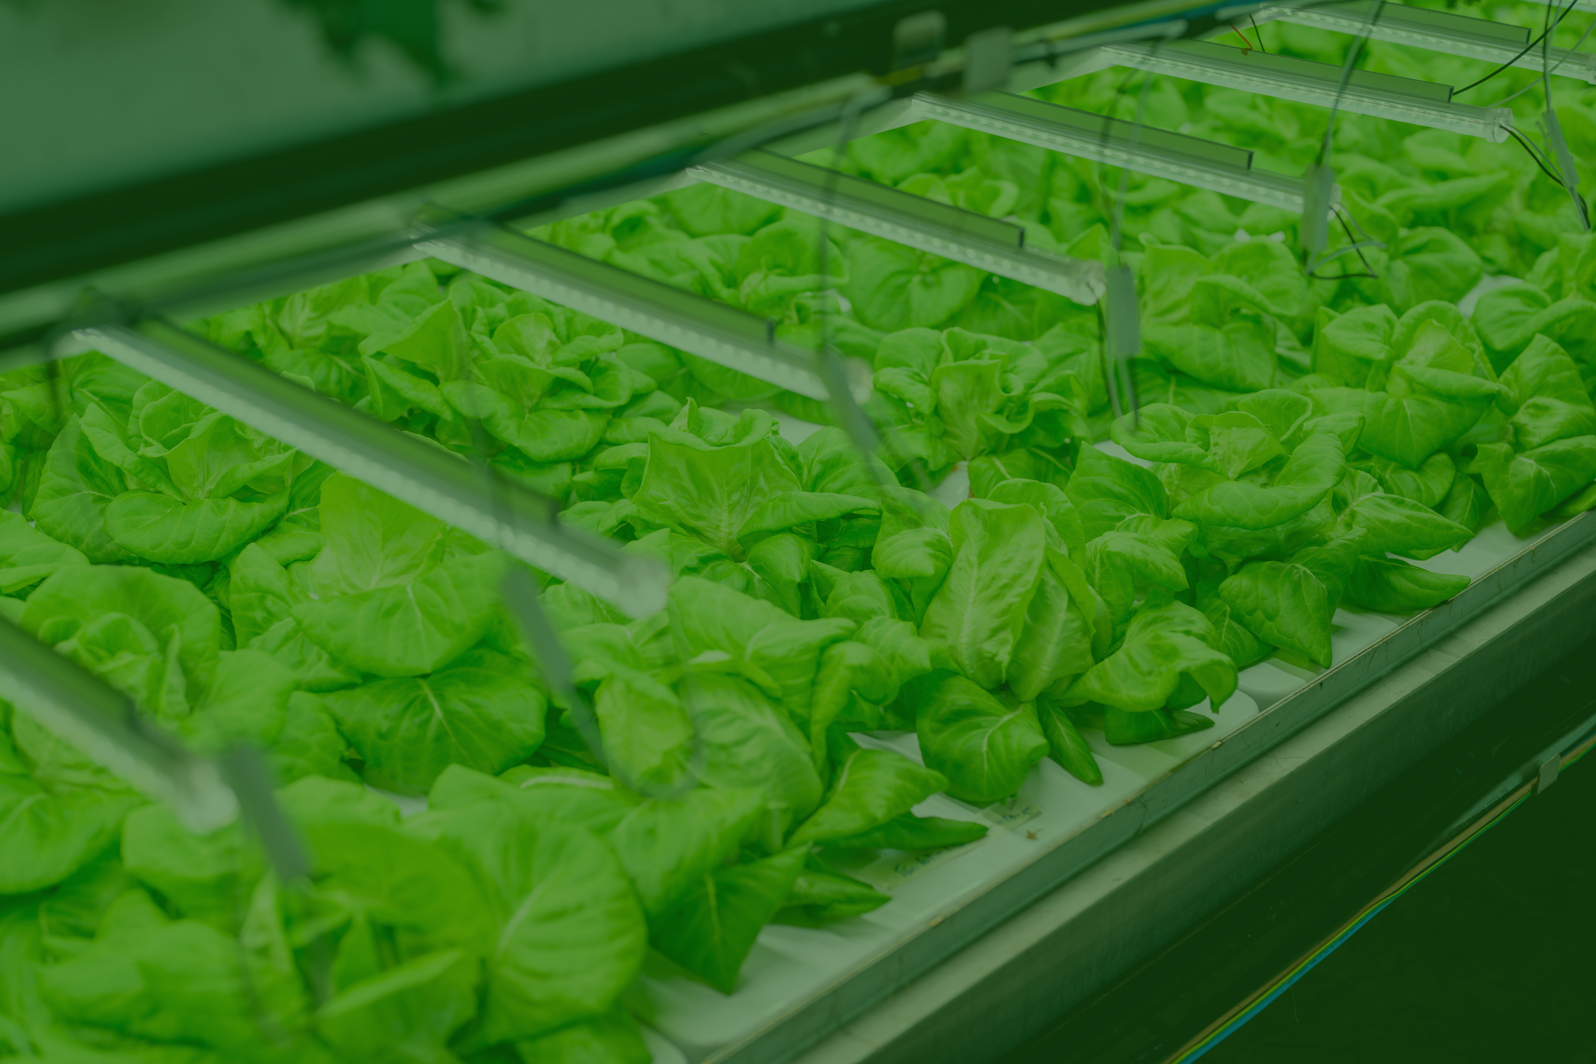
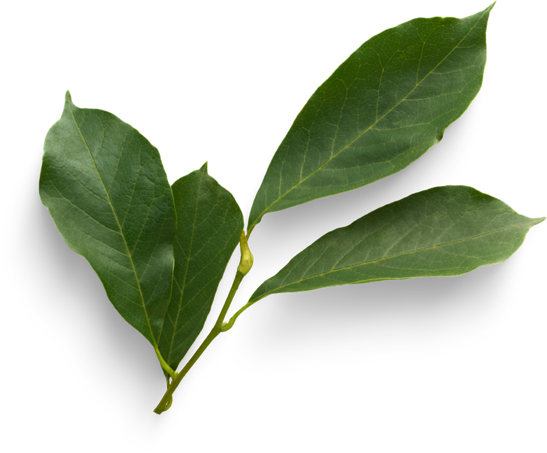
THANK YOU

